Slide 1
ML Introduction
09/29/2021
Abhishek Bharani
Notes:
Machine Learning is the use of data and algorithms to perform human level tasks. Here algorithms are trained to act without explicitly programming them, it involves showing an algorithm lots of data and then making predictions on real world data.
It’s quite interesting that the whole world of computer science is changing. Previously you need to understand the algorithm and then code that algorithm in whatever language you want but with machine learning it’s not teaching the algorithm how to solve but showing the algorithm how to solve the problem and it learns it by itself.
Deep Learning and Machine Learning are used interchangeably. However, deep learning is actually a sub-field of machine learning, and neural networks is a sub-field of deep learning.
Classical ML algorithms such as SVM, Naive Bayes etc. does not involves human intervention to process data whereas deep learning algorithms automates much of the feature extraction piece of the process and enables use of larger datasets. Other way to call deep learning is “scalable machine learning”.

Slide 2
Types of ML
Supervised
Learning
Unsupervised
Learning
Reinforcement
Learning
Notes:
Supervised machine learning
Supervised learning, also known as supervised machine learning, is defined by its use of labeled datasets to train algorithms that to classify data or predict outcomes accurately. As input data is fed into the model, it adjusts its weights until the model has been fitted appropriately. This occurs as part of the cross validation process to ensure that the model avoids overfitting or underfitting. Supervised learning helps organizations solve for a variety of real-world problems at scale, such as classifying spam in a separate folder from your inbox. Some methods used in supervised learning include neural networks, naïve bayes, linear regression, logistic regression, random forest, support vector machine (SVM), and more.
Unsupervised machine learning
Unsupervised learning, also known as unsupervised machine learning, uses machine learning algorithms to analyze and cluster unlabeled datasets. These algorithms discover hidden patterns or data groupings without the need for human intervention. Its ability to discover similarities and differences in information make it the ideal solution for exploratory data analysis, cross-selling strategies, customer segmentation, image and pattern recognition. It’s also used to reduce the number of features in a model through the process of dimensionality reduction; principal component analysis (PCA) and singular value decomposition (SVD) are two common approaches for this. Other algorithms used in unsupervised learning include neural networks, k-means clustering, probabilistic clustering methods, and more.
Reinforcement learning
Reinforcement machine learning is a behavioral machine learning model that is similar to supervised learning, but the algorithm isn’t trained using sample data. This model learns as it goes by using trial and error. A sequence of successful outcomes will be reinforced to develop the best recommendation or policy for a given problem.

Slide 3
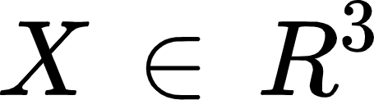
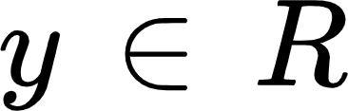
General Setup for ML Algorithms
Supervised Learning - Learn from many labeled examples.
For e.g. let’s say we want to model the rent of an apartment given the size of living area, # of bedrooms, ceiling height etc.
Predict Rent given :
Living area (sq ft) | # bedrooms | Ceiling height (ft) | Rent ($)
1000 | 3 | 10 | 1200
1200 | 2 | 8 | 1300
1400 | 4 | 8 | 1800
Feature space : we need to predict from there are 3 features
Output of the model
Notes:
In any supervised ml setup : we need to predict output given set of features. But this is not how human learns we don’t need much context to predict that object is car or laptop because we already have the context built in our memory. Where as this learning algorithms starts from scratch so they need to look into lots and lots of examples.
We have many examples of rent given the input and the output is a real number. Our goal is basically, predict the rent but if you see we have an irrelevant feature of ceiling height which may not be important in predicting rent but we want learning algorithm to determine that it is irrelevant (we don’t want to exclude it from input).

Slide 4
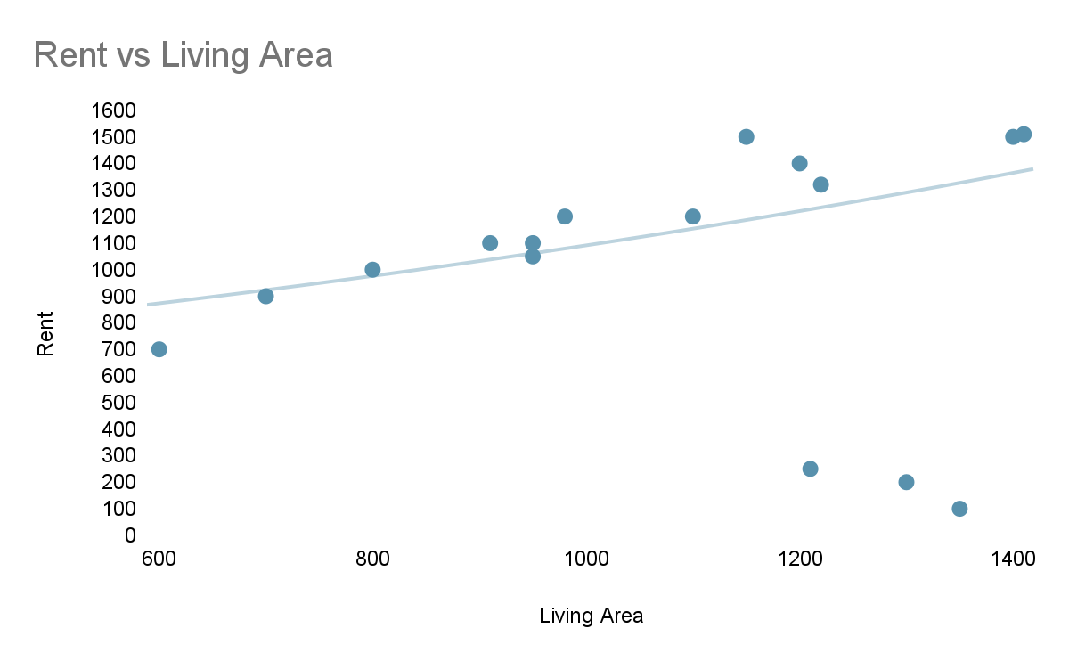
Goal : Learn a model to predict the rent from features
Notes:
Let’s focus on one feature (living area) and we are trying to predict the rent. The scatter plot will have an approximation along the trend line and our goal is to learn this trend line. You may notice that there are few outliers which are paying less rent with larger living area , this is should be handled in data cleaning process.
More general problem

Slide 5
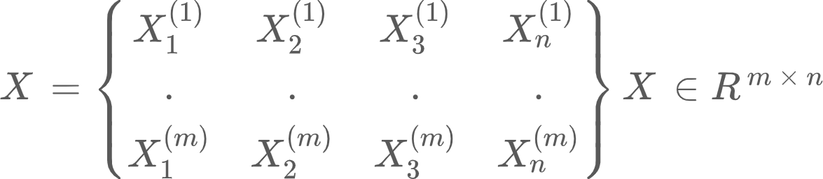

Few Notations
Training Examples :
m : training set size
n : number of features
All deep learning libraries are row-major i.e put the data points in the rows of a data matrix.
Label Matrix

Slide 6
How ML algorithm works - General Flow
Before we introduce the general flow of how these algorithms works, let me introduce two new terms:
Regression : predicting continuous variable like rent it’s a real value.
Classification : predicting discrete variable like binary (0 or 1). Cat vs Dog.
In a general,
Learning Algorithm / Hypothesis / Model
h
Predicted
y = h(x)
Training Set (x)
Notes:
Regression is predicting continuous variable like rent it’s a real value.
Classification is predicting discrete variable like binary (0 or 1). Cat vs Dog.
This is general flow of machine learning and this also comes in vision . That’s the high level introduction to supervised learning.
Let’s start with first algorithm : Linear Regression and again consider the rent problem :
Predicting rent using three features ;

Slide 7

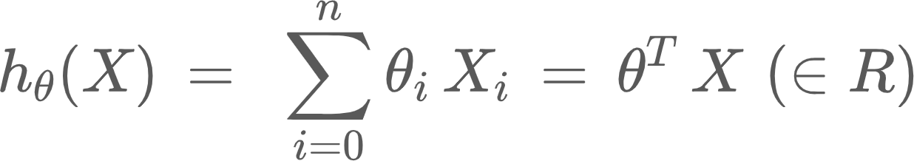
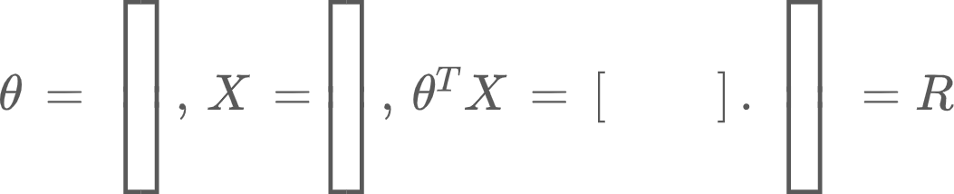
Linear Regression
Represent model as
We need find set of parameters that matches the training set X.
Notes:
Our goal :We need find set of parameters theta that matches the training set X.
Our feature matrix is x_o = 1 and have n+1 elements.
We call it inner product.

Slide 8
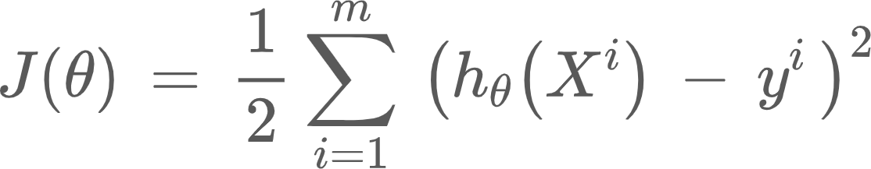
Loss Function
Small if we are closer to large value and large if we are away from target value. Also, called as Ordinary least squares Cost.
Notes:
How do we calculate the whether the given theta is good for my model ; we need some way of measure the quality of the hypothesis.
The cost function in this case for linear regression is defined as :
Derivative of quadratic function is linear and this results in linear system.

Slide 9
Logistic Regression
Sign of inner product determines which side of the line you are.
Notes:
Gender : Depending upon browsing behavior predict gender,
Loan Approval : loan repayment decision using financial data.

Slide 10
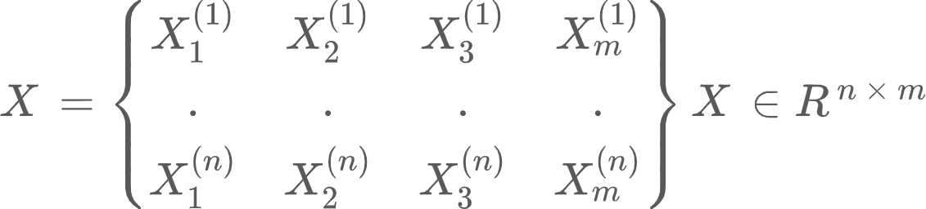
Few Notations
Training Examples :
m : training set size
n : number of features
All deep learning libraries are row-major i.e put the data points in the rows of a data matrix.
Label Matrix

